Slide 1
Product Recommendation System Using NLP Technique
BY: Jugal Kishore Gandhesiri Department of Computer Sciences Texas A & M University - Corpus Christi Corpus Christi, Texas, USA, 78414 jgandhesiri@islander.tamucc.edu

Slide 2
CONTENTS
Introduction
Related Works
Proposed Framework
Data Analysis
Differences
Experiments
Conclusion & Future Works

Slide 3
INTRODUCTION
Product Recommendation System Using NLP Technique aims to
To propose a new type of recommendation system with combinations of various filtering methods and NLP technique on the basis of a neural network model.
To provide recommendations based on three main parameters such as Product Description, Review and Rating.

Slide 4
INTRODUCTION (CONT …)
For Example:
User Searches for a book called “Ace the Data Science Interview”.
NLP Divides {[Ace],[Data Science],[Interview]}
Collaborative model : Analyzes the User Ratings of the product using the product #id and User #id for finding similar products.
Content Based model : Analyzes the description, reviews and ratings of the product to find similar products.

Slide 5
INTRODUCTION (CONT …)
Both the models provide scores for the set of their individual results.
After obtaining the results of the Collaborative Filtering model and the Content-Based model, we combine them with a linear combination of their scores, then we classify the list and we take the first “N” recommended items, finally, we use the selected results and we classify them again according to the Self-organizing map from best to worst and show the first “N” items as recommendation.

Slide 6
RELATED WORKS
Product Recommendation System Using NLP Technique can be divided to various subtasks: Recommendation system using a filtering methods,Recommendations using NLP and other Machine Learning Algorithms.
Most of existing studies focused on these subtasks.
The main aim of the subtasks is to provide recommendations based on specific user profile.

Slide 7
PROPOSED WORK
In our proposed architecture we combine both the user profile based algorithms as well as product ratings and reviews on top of a neural network model to result top N recommendations.
Collaborative Filtering algorithm analyzes their favorite products and integrates them into a categorized list of suggestions based on user ratings.
Content Based Filtering algorithms use the descriptions of the items and profile of user’s preferences.

Slide 8
PROPOSED WORK (CONT …)
We use Bag of words(BOW) model to extract text and analyze the description and reviews of the products.
We will use BOW technique to find the similar type of words in the description and reviews that can relate to each other.
TF-IDF is a strategy for quantifying a word in a description by assigning a weight to each word that represents the importance of words in the corpus.

Slide 9
PROPOSED WORK (CONT …)
Self-organized map : We should think of neural networks as a layer of clustering and classification on top of the data we store and handle, as they assist us in clustering and classifying data. The self-organized map is a neural network, and it is the technique we will be using in this recommendation system.

Slide 10
PROPOSED WORK (CONT …)
Adjusted Rating Score
An adjusted rating system was introduced to adjust the rating of each product to account for extreme ratings and balance out ratings for products that had several thousand reviews to products that only had a hundred or so. Products with less reviews were more likely to be affected by a series of ratings than products with more reviews, both positively and negatively. We want a balance.

Slide 11
PROPOSED WORK (CONT …)
The adjusted rating score essentially does two things that make it better than a simple average rating:
Takes in the average rating of the product (perceived quality over popularity)
Takes in the number of ratings by customers (popularity over perceived quality)

Slide 12
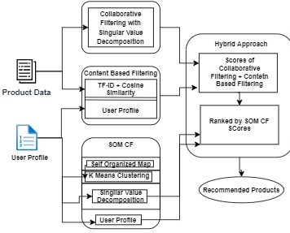
OVERVIEW OF PROPOSED MODEL

Slide 13
DATASET & ANALYSIS
I have considered two benchmark datasets for analysis where one of them is product review datasets and other is a Product metadata.
Our dataset has the data of Amazon. Dataset contains around 5,813,109 rows. The dataset has 9 columns giving information about each product. Some of these attributes are not useful for us in building a recommender system.
We also use the user review data for the same category for which we can find the reviews and ratings for each product.

Slide 14
DATASET & ANALYSIS (CONT …)
{ "reviewerID": "A2SUAM1J3GNN3B",
"asin": "0000013714",
"reviewerName": "J. McDonald",
"helpful": [2, 3],
"reviewText": "I bought this for my husband who plays the piano. He is having a wonderful time playing these old hymns. The music is at times hard to read because we think the book was published for singing from more than playing from. Great purchase though!",
"overall": 5.0,
"summary": "Heavenly Highway Hymns",
"unixReviewTime": 1252800000,
"reviewTime": "09 13, 2009" }
{
"asin": "0000031852",
"title": “FLIP FLOPS",
"price": 3.17,
"imUrl": "http://ecx.images-amazon.com/images/I/51fAmVkTbyL._SY300_.jpg"
“description” : “Made of Rubber.Manfactured by Old Navy USA”}

Slide 15
DATASET & ANALYSIS (CONT …)
In our analysis we were able to look at:
The distribution of ratings among products and customers.
Determine the most popular products and categories.
Look at the highest rated categories and see what affects rating averages.
Observe how ratings change over time.

Slide 16
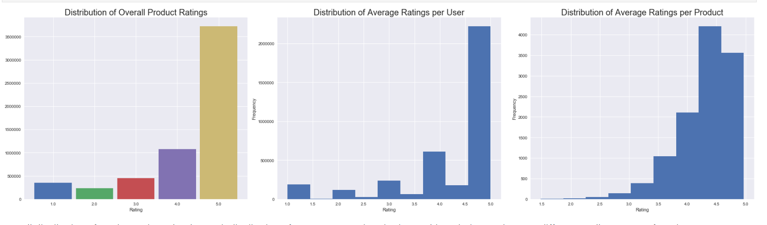
DATASET & ANALYSIS (CONT …)
Overall distribution of product ratings closely match distribution of average user ratings in shape, although the numbers are different. Well over 50% of products average a 4.5 or higher rating, while over 90% have a 3.5 or higher rating. Typically, products on amazon are highly rated on average with under 250 total products out of 11,500+ having an average rating under 3.0.

Slide 17
DIFFERENCE
The main difference between my proposed method and the other methods which I took as a reference is that:
In our system, a new recommendation system is proposed, which is based on four steps, namely Collaborative, Content-Based, Self-Organizing Map Collaborative Filtering, and Hybrid Model.
Implicit user ratings are calculated using the singular value decomposition approach in the collaborative filtering part, we use also the item's textual features to build a content-based model.

Slide 18
DIFFERENCE (CONT …)
This system also overcomes the common issues in recommendation systems such as the cold start problem.

Slide 19
EXPERIMENTS & EVALUATION
We have performed various tests to understand the accuracy of the recommendation Engine.
Following experiments have been performed:
Test Keyword Search Module.
Time it takes the recommendation system to go through each threshold.
Observe how the recommendation system performs with a product with a very large amount of purchases.
Observe how the recommendation system performs with a product with a very little amount of purchases

Slide 20
EXPERIMENTS & EVALUATION
We cross validate, train-test-split, predict, find nearest neighbors, tune algorithms, perform grid searches using Surprise Package.
Sampling the Dataset : The dataset is extremely large and causes the kernels to die as we try to analyze and predict data, we have adjusted our sample sizes accordingly in order to process information in a reasonable amount of time.
Selecting and Tuning an Algorithm : We will have selected the best recommendation algorithm out of various others. In benchmarking our algorithms we will see which one gives the best RMSE score using a random sample of 50000 ratings in our dataset.

Slide 21
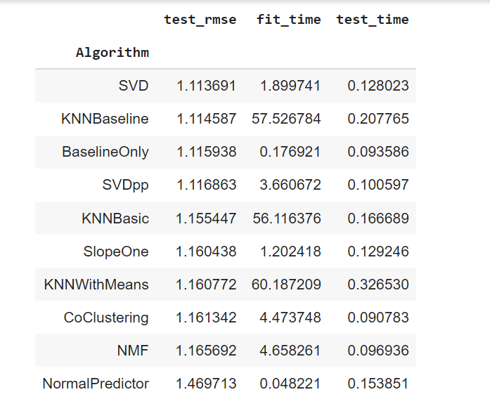
EXPERIMENTS & EVALUATION

Slide 22
EXPERIMENTS & EVALUATION
SVD gives the best RMSE so we will move along with SVD.

Slide 23
EXPERIMENTS & EVALUATION
RMSE: 1.0762 1.0761692357254327 CPU times: user 16min 47s, sys: 13.1 s, total: 17min Wall time: 17min 37s
The tuned algorithm performs worse on the full dataset so we will re-tune the hyperparameters and try again.
RMSE: 1.0593 1.059264022518196 CPU times: user 4min 25s, sys: 4.85 s, total: 4min 30s Wall time: 4min 43s
We see that the re-tuned algorithm performs better than the default, so we'll move along with the specified hyperparameters.

Slide 24
CONCLUSION & FUTURE WORK
Unlike content based filtering, which suggest only similar products or domain specific products, our recommendation systems allows users to find similar products and jump (or switch) to other categories of products based on similarities with other users and products. In this case, we explored 3 different ways to use our Recommendation System.
The first method suggests products that other users like to a specific user based on their rating of a specific product. Essentially, it finds users that rated a product similar to the specific user and returns the top products the other users liked. This method was used as an introduction to recommendation systems with a simple, built from scratch, recommender that did not incorporate actual training of models or prediction methods.

Slide 25
CONCLUSION & FUTURE WORK
The second method predicts what products a user may like based on past rating history and the rating history of other users. This method is not specific to the rating of one product like the first method. It is a ratings based method that predicts the expected ratings a user would give a product and ranks the highest expected rated products for that user. Unfortunately this method had to use a sample of the full dataset to train.
The third method predicts products similar to a specific product by finding the nearest neighbors to that product. This method is good for users who may want to purchase products as bundles. It is not ratings or user based as the previous two methods are.

Slide 26
CONCLUSION & FUTURE WORK
I feel that our limited time and computational power prevented us from making the best predictions in selecting and tuning our model as well as making product predictions for specific users. In the future, I would like to work on training the complete dataset instead of a very small percentage (10% and less).

Slide 27
REFERENCE
Akhilesh Kumar Sharma, Bhavna Bajpai, Rachit Adhvaryu, Suthar Dhruvi Pankaj Kumar, Prajapati Parth Kumar Gordhan Bhai, Atul kumar, ``An Efficient Approach of Product Recommendation System using NLP Technique'' July 2021 Materials Today: Proceedings,August 2021.
Amy Trappey,Charles V.Trappey,Alex Hsieh, ``An intelligent patent recommender adopting machine learning''Technological Forecasting and Social Change,Volume 164, March 2021, 120511.
Yassine Afoudi,Mohamed Lazaar,MohammedAl Achhab ``Hybrid recommendation system combined content-based filtering and collaborative prediction using artificial neural network''.Simulation Modelling Practice and Theory,Volume 113, December 2021, 102375.
Michele Gorgoglione, Umberto Panniello, Alexander Tuzhilin ``Recommendation strategies in personalization applications`` Information & Management Volume 56, Issue 6, September 2019, 103143.
Hernández del Olmo F., Gaudioso E.Evaluation of recommender systems: A new approachExpert Syst. Appl., 35 (2008), pp. 790-804K R., Kumar P., Bhasker B.DNNRec: A novel deep learning based hybrid recommender systemExpert Syst. Appl., 144 (2020), Article 113054.
R.V. Karthik, S. Ganapathy``A fuzzy recommendation system for predicting the customers interests using sentiment analysis and ontology in e-commerce''.Appl. Soft Computing, 108 (2021), p. 107396, 10.1016/j.asoc.2021.107396.

Slide 28
Thank You

